Slide 1
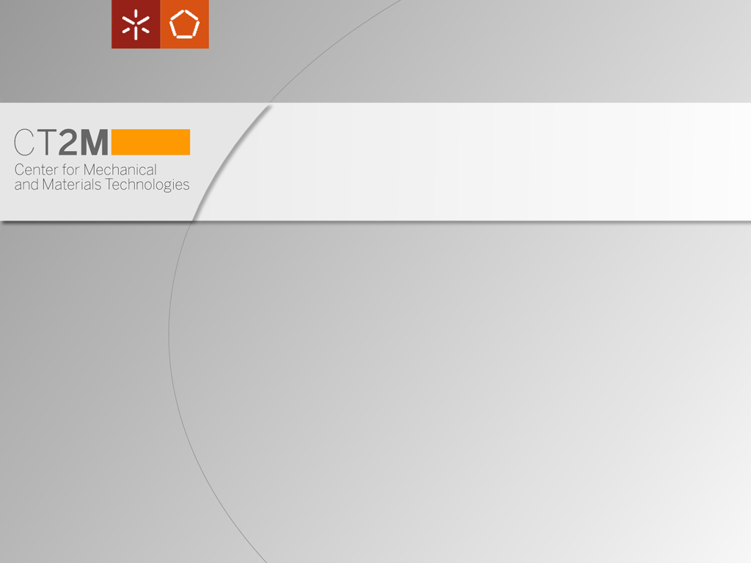


International Conference on Engineering Education
ICEE-2010
July 18–22, 2010, Gliwice, Poland
Competency-Based Education in the Design of Medical Rehabilitation Devices: a Case Study
Dynamics of Mechanical Systems
Eurico Seabra | Luís F. Silva | Paulo Flores | Mário Lima
Department of Mechanical Engineering
University of Minho
School of Engineering
Campus de Azurém
4800-058 Guimarães
Portugal

Slide 2
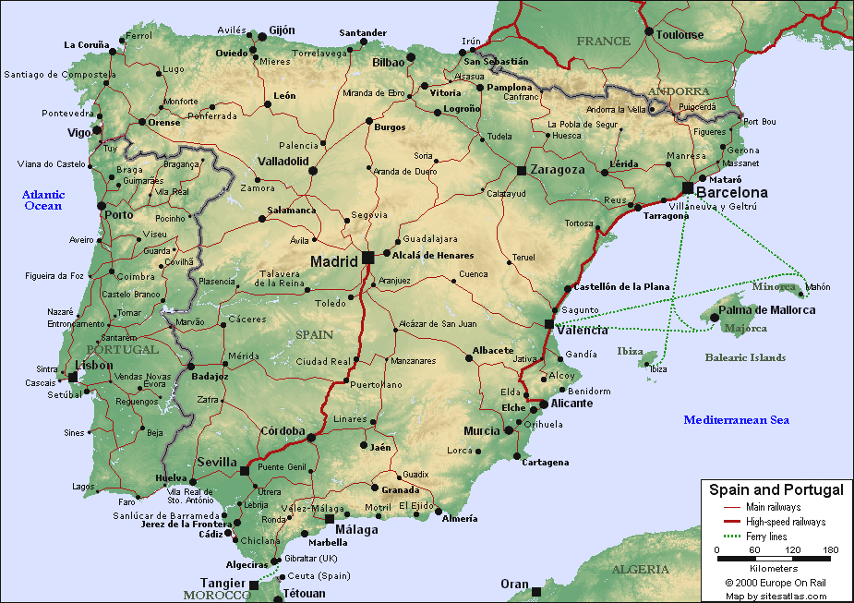
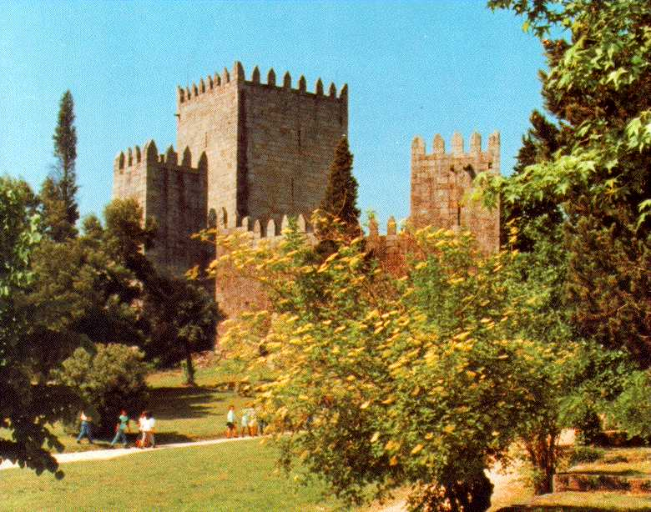

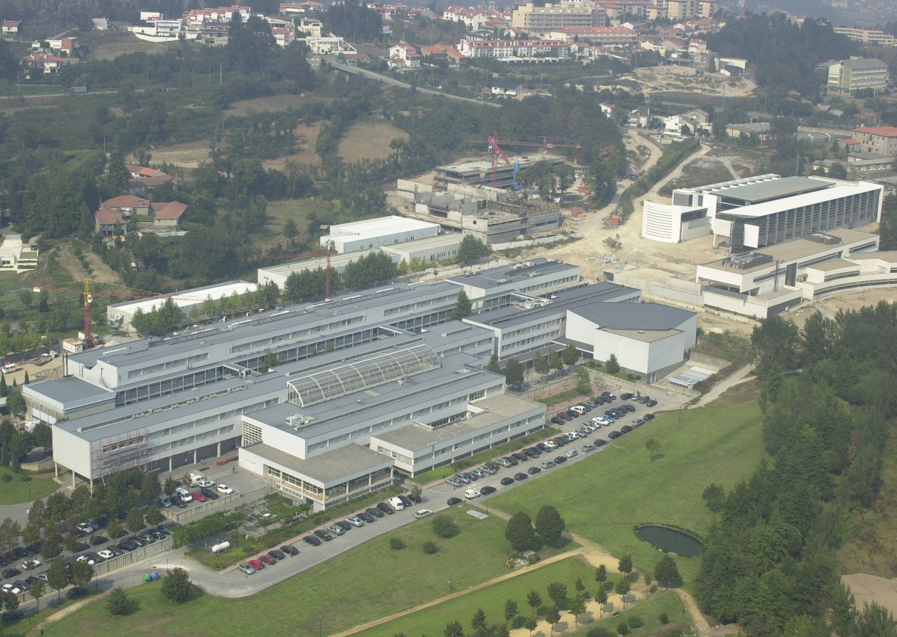
About us…
Where are we?
Guimarães
European Capital of Culture
Biomechanics
Group:
The
University of Minho
in Guimarães

Slide 3
Summary
Introduction;
The curricular unit (brief presentation);
Overview of the medical and rehabilitation devices:
  Shoulder rehabilitation device project;
  Standing frame project;
  Dress and undress aid device project, and
  Wrist rehabilitation device project.
A case study: Feeding aid device project;
Concluding remarks.

Slide 4
Introduction
To reduce the potential healthcare costs arising from a rapidly aging industrial world population, the problem of sustaining independent living for the elderly and persons with low to high levels of disabilities must be addressed.
Medical rehabilitation research is directed towards restitution and improvement of functional capability lost as a consequence of injury, disease and congenital disorder of children and adults.

Slide 5
Introduction
The mission research is to improve the ability of medical rehabilitation to restore or improve function through research on:
  functional problems associated with diminished mobility;
  body systems response to lost function;
  adaptive behaviour systems modifications to functional loss;
  treatment intervention effectiveness in restoring function;
  assistive devices that replace or enhance function, and
  outcome measurement systems that provide an integrative method for tracking functional change over time in many different domains.

Slide 6
Introduction
This presentation focus the development of assistive devices that replace or enhance function, which is the scope of the Curricular Unit (CU)
Design of Medical and Rehabilitation Devices (Integrated Master course in Biomedical Engineering, specialization area of Biomaterials, Rehabilitation, and Biomechanics), where:
  The concepts associated with Competence-Based Education are applied using the methodology of problem-based learning/teaching strategies, and
  The students are active participants rather than passive observers in the learning process, because the knowledge is learned and applied in a realistic problem solving (making decisions, solving problems and analysing the results).

Slide 7
The Curricular Unit
Design of Medical and Rehabilitation Devices (Integrated Master course in Biomedical Engineering, specialization area of Biomaterials, Rehabilitation, and Biomechanics)
CAE tools
Mechanics
Engineering design methods
Fluent™ software
Electronics
Design of Medical and Rehabilitation Devices
Theoretical
and
Practical
lectures
2h/week each
Development of a practical semester assignment
Case studies
CAD software tools
Pneumatics
Software
Hydraulics

Slide 8
Overview of the medical and rehabilitation devices
There are many examples of assistive devices for people with manipulative and locomotive disabilities. These devices enable disabled people:
  to perform many activities in their daily live, improving their quality of life, and
  to be able to lead an independent life, playing a more productive role in society.
Some of the main projects that were studied in the CU mentioned are:
  Active and passive system for shoulder rehabilitation;
  Standing frame for rehabilitation of children with mental deficiency;
  System to help dress and undress activities of disabled individuals in wheel chairs;
  Active and passive system for the wrist rehabilitation;
  Feeding device to assist motor or mental handicapped people.

Slide 9
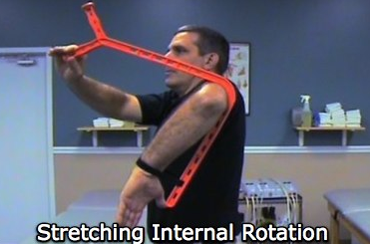
Overview of the medical and rehabilitation devices
Shoulder rehabilitation device project
The aim was to develop a new device for the rehabilitation of the shoulder:
  a survey of the physiological characteristics of the shoulder was carried out (regarding the different types of movements provided by this joint and its most common pathologies);
  a survey of the commercially available applications was also carried out, as well as
  the identification of the specifications of the final product.
        The idea came after the analysis of the Rotater, that allows the user to passively self-stretch internal and external shoulder rotation to increase shoulder function, range of motion and performance.
        The conceived device fulfills all the characteristic features needed as a rehabilitation mechanism, in terms of:
          safety, and
          comfort,
        being also capable to provide an adaptive rehabilitation which is quite useful during all stages of recovery:
          an active rehabilitation scheme, or
          an passive rehabilitation scheme.
Adopted from [http://therotater.com/wp/].

Slide 10
Overview of the medical and rehabilitation devices
A new system was then proposed that adapts an existing arrangement (where the patient exerted his strength by using the other arm), to which a motor was attached to operate the mechanism to exercise the shoulder of the patient, without exerting any force during the rehabilitation procedure.
3D modeling of the designed device for shoulder rehabilitation: (Left) Active device and (right) Passive device.

Slide 11
Overview of the medical and rehabilitation devices
Standing frame project
A standing frame is a mechanical or mechatronic equipment that aims to correct the inability of individuals to assume the vertical position.
The available standing frames do not:
  enable an easy positioning and placement of the individual on the device,
  permit full mobility (inside and outside buildings),
  are not versatile, modular, and
  do not allow children to have occupational activities during treatments.

Slide 12
Overview of the medical and rehabilitation devices
The standing frame designed is to be used in the treatment of children mental handicapped, after taking into account the drawbacks mentioned previously and it is perfectly adapted to this specific targeted individuals.
The main features are:
  modularity,
  frame easily operated, and
  Frame easily used (especially when the handicapped need to travel with the the standing frame).
Overall 3D views of the developed standing frame.

Slide 13
Overview of the medical and rehabilitation devices
Dress and undress aid device project
Main objective: the design and development of a device to help individuals with paraplegia to dress and/or undress.
The whole design was based on the procedure for dressing or undressing pants and for individuals with a maximum weight of 120 kg.
The proposed solution is a system to be adapted to a common wheelchair, which will have a ramp or a hydraulic pump that be driven by the handicapped individual.

Slide 14
Overview of the medical and rehabilitation devices
Operation principle:
The individual can elevate her/his legs through a crank or pump, and using a vest and a simple device (attached to the back of the wheelchair) may also elevate the pelvis to pull up or down the pants.
Other advantages:
The designed alternative to enable the lifting or lowering of the handicapped legs provides a more extensive use of the device, since the use of the pump can cover other handicapped individual groups, as is the case of amputees.
3D schematic representation of the lifting solution for the handicapped legs.

Slide 15
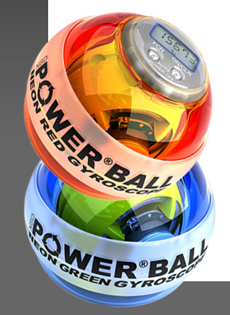
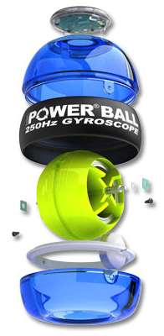
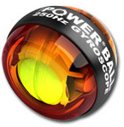
Overview of the medical and rehabilitation devices
Wrist rehabilitation device project
Although there are several systems and devices to carry out the rehabilitation of this articulation, there is a lack of mechanical devices to provide passive and active rehabilitation movements during the recovery process.
The operating principle of an existing equipment was the basis for this project development, because its application was promising in the context of rehabilitation (the Powerball® [http://www.powerballs.com/]).
Adopted and adapted from
[http://www.powerballs.com/]).

Slide 16
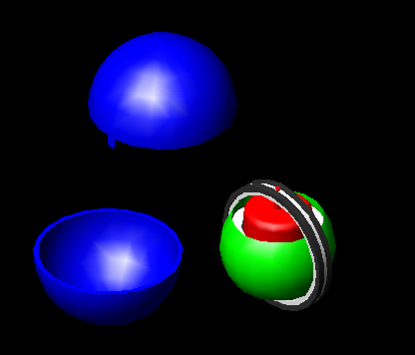
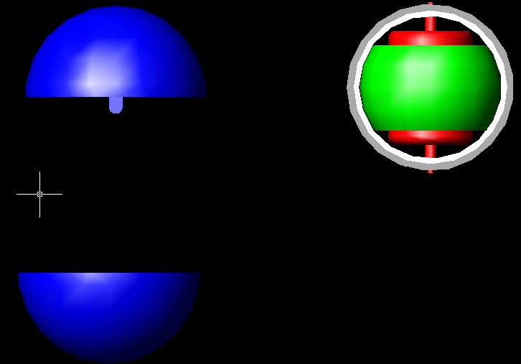
Overview of the medical and rehabilitation devices
The PowerBall®:
…is a ball with carefully balanced weights, so it could rotate around their axes, creates a centrifugal force effect.
…it operates as a gyroscope with its kinetic motion allowing the recovery and strengthen of the wrist joints.
One of the objectives of this project is to evaluate and assess the limitations of this equipment and to suggest a possible improvement, to generalize its application to wrist and other body parts pathologies.
3D Models of the proposed wrist rehabilitation device.

Slide 17
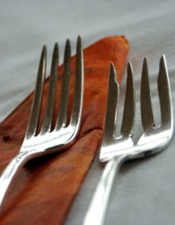
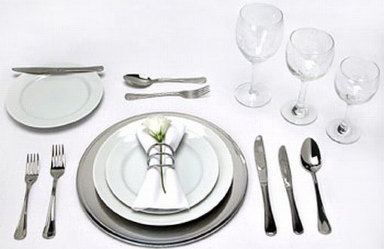
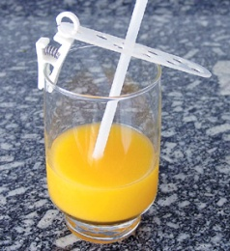
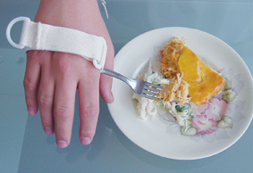
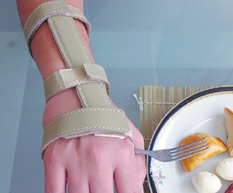
A case study:
Feeding aid device project
Introduction
The main motivation is that the eating process is one of the most important activities in everyday life.
Eating activity influences many aspects of our overall medical, physical, and social well being:
  Gustafsson (1995) evaluated the psychological effects of self-feeding and found that disabled individuals who attained their goals of self-nourishment had a heightened sense of control, security and hope for the future.
  The inability to feed oneself has been linked to shame for human incompetence, decreased self-esteem and feelings of panic or fear.
This information supports attempts to study feeding devices that assist individuals unable to feed themselves.
Adopted from:
http://www.mnsuprimentos.com.br/

Slide 18
A case study:
Feeding aid device project
Initial design stages
To develop the needed mechanical system for the aid device, it is important to know the natural (human) feeding trajectory.
An experimental analysis of the feeding movement was performed and it was concluded that the trajectory is not linear: it approaches to a parabola or even to a Sigmoid function:
(Left) Quadratic function; (Right) Sigmoid function.

Slide 19
A case study:
Feeding aid device project
Initial design stages
The paths are most appropriate for the use in a mechanism with a motor, since it transmits a continuous and progressive movement.
However, it is essential to find a suitable mechanism to replicate this trajectory with a driven motor only:
    it is fundamental to stop the mechanism in a specific point to allow the patient’s feeding.
    it is also desirable that the described trajectory is cyclical and that it should incorporate the individual’s mouth in one of the trajectory points.
For that it was necessary to select the most appropriate mechanism to accomplish these requirements.

Slide 20
A case study:
Feeding aid device project
Mechanisms
A Watt mechanism was considered first: a four-bar linkage that returns a trajectory in form of “8”, which could satisfy the initially imposed conditions!
This mechanism presents however two problems:
the point that describes the intended trajectory it is the medium point of the central bar (coupler link), which represents a physical obstruction for placing the spoon;
this mechanism is driven by a bar with an alternate motion (input link), which requires the change of the rotation of the motor.
It is also the difficulty to maintain the horizontal position of the spoon during the whole trajectory.

Slide 21
A case study:
Feeding aid device project
Mechanisms
The Chebyshev mechanism was also studied. It returns a “half moon” trajectory that is much easier to maintain the horizontality required for the spoon.
However, this mechanism presents the same problems as the previous one, because the point that describes the trajectory is the medium point of the central bar (coupler link), also requiring an alternate driving motor.

Slide 22
A case study:
Feeding aid device project
Mechanisms
The Hoekens mechanism (a variation of the Chebyshev mechanism) was also analyzed with the advantage of having the trajectory defined by the end of one bar (point P1).
With this mechanism it is possible to fulfill the two main system requirements: to perform the trajectory with the intended end point, while the mechanism is driven in only one rotation direction, since the driven bar carries out a motion of 360°.

Slide 23
A case study:
Feeding aid device project
Mechanisms
The four bar linkage finally selected was the Burmester mechanism, which is similar to the Hoekens mechanism.
The orientation of the fixed body in this mechanism relatively to the obtained trajectory is different and, due to this reason, it was considered more appropriate to the aid feeding system to be developed.

Slide 24
A case study:
Feeding aid device project
3D conceptual design and animations
After the selection of the mechanism that best fits the intended trajectory, a 3D CAD model was built to enable its analysis.
Using AutoCAD® (Autodesk) it was possible to find the appropriate relationships between the lengths of the bars to describe the required trajectory:
it was obtained a length ratio of 2:1 between the fixed bar (B1) and the driven bar (B2), and
a length ratio of 1:2 between the fixed bar (B1) and the remaining bars (B3, B4 and B5).
the bar of different geometry was replaced by two other bars (B4 and B5) linked together.
3D model of the feeding aid device.
Rotation joints were used for the bars linkage.

Slide 25
A case study:
Feeding aid device project
3D conceptual design and simulation analysis
To evaluate and validate the proposed device, the mechanism motion was analyzed by using a commercial software specially dedicated to these “type” of mechanical systems.
Working Model 4D (MSC.Software) was used to carry out the kinematic analysis of the displacement of the spoon, and to determine the performance of the overall feeding system.

Slide 26
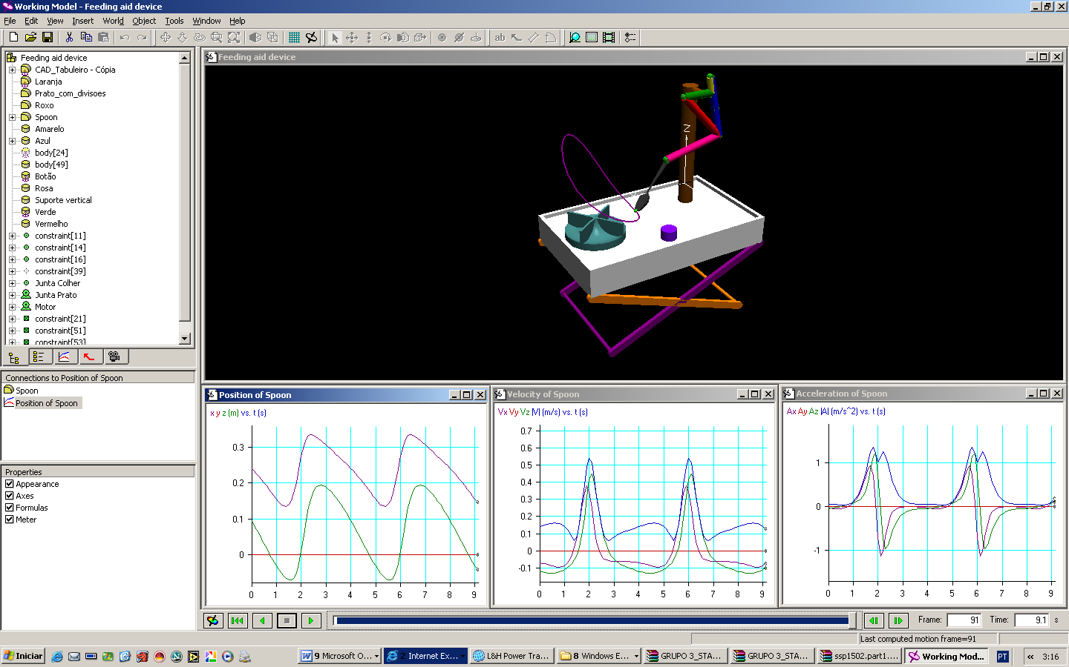
A case study:
Feeding aid device project
3D conceptual design and simulation analysis
Once defined all characteristics of the mechanism, it was possible to carry out the kinematic analysis where the output variables are the position, velocity and spoon acceleration:
Kinematic analysis of the developed feeding aid device using the Working Model 4D software.

Slide 27
A case study:
Feeding aid device project
3D conceptual design and simulation analysis
Conclusions:
Based on these simulation results, it can be concluded that the developed mechanical system is appropriate as a feeding aid device, because it enables to obtain the required spoon trajectory in a continuous motion.
Kinematic analysis of the developed feeding aid device using the Working Model 4D software.

Slide 28
Concluding remarks
The integration of knowledge, skills and performance relating to Competency-Based Education in the teaching of engineering design methods for the design and development of medical and rehabilitation devices was implemented at the Department of Mechanical Engineering (UMinho) based on case studies.
Some case studies have been presented and discussed, with a special focus on the design of a feeding device to assist motor or mental handicapped individuals.

Slide 29
Concluding remarks
The role of the teachers in this learning process, in the CU of “Design of Medical and Rehabilitation Devices”, was just to tutor and to support and guide students in practice.
The students were free to choose between several ways of gathering information and to decide which was the best way to accomplish the objectives for each one of the proposed case studies.
The results of the implementation of these learning methodologies were very positive, since good results have been obtained, for all students, in all assessment stages throughout the semester.

Slide 30
Concluding remarks
Skills acquired by the students:
(...)
Automation
Ability to collect relevant information
... to design and develop
Opportunity to participate in R&D activities
Mechanisms analysis
Group
work
Product design
Engineering design methods
CAD tools
Motion simulation software
(...)

Slide 31
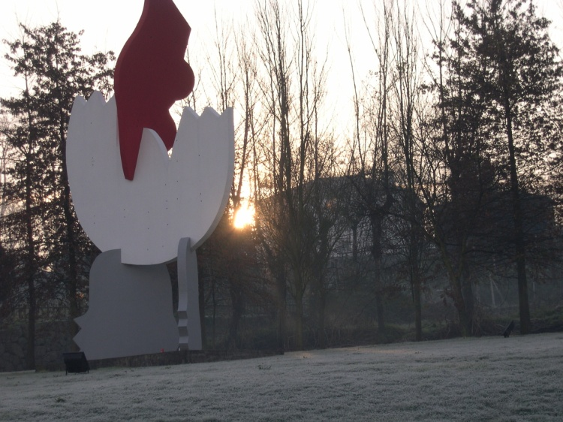
International Conference on Engineering Education
ICEE-2010
July 18–22, 2010, Gliwice, Poland
THANK YOU
Dynamics of Mechanical Systems
Competency-Based Education in the
Design of Medical Rehabilitation Devices:
a Case Study
  {eseabra, lffsilva, pflores, mlima}@dem.uminho.pt
+351 253 510 220
 +351 253 516 007

