Slide 1
Development of Software for philanthropic institutions in a extension service project at Positivo University
Authors:
Maristela Regina Weinfurter Teixeira, Positivo University, maristela.weinfurter@up.edu.br
Marcelo Mikosz Gonçalves, Positivo University,marcelo@up.edu.br
Edson Pedro Ferlin, Positivo University,ferlin@up.edu.br

Slide 2
Agenda
Introduction
The Challenge
Development Phases
Results
Final Considerations

Slide 3
Introduction
Education chalanges:
integration of theory and practice
realization of multidisciplinary projects
Brazilian Law of Directing and Basis of Education (LDB): “The Education shall commit itself to the world of Work and social practice.”
UNESCO: Learning to live together.

Slide 4
The Challenge
The students of computer engineer program were divided in three teams:
Physiotherapy clinic at Positivo University
Acridas (that in Portuguese stands for Christian Social Work Association)
JOCUM (in Portuguese stands for Youth With A Mission's YWAM)
To visite the entity find their needs and develop software solution.

Slide 5
Development Phases
First Bimester
Requirement phase using organizational semiotics (for general requirements) and UML Use Case Models.
Second Bimester
Software analysis, modeling ( UML Class, sequence, collaboration, objects, activities and packages diagrams)
Thirth Bimester
Software codification and testing (usability tests, Black box and White Box)
Fourth Bimester
Deployment, Training and final adjustments

Slide 6
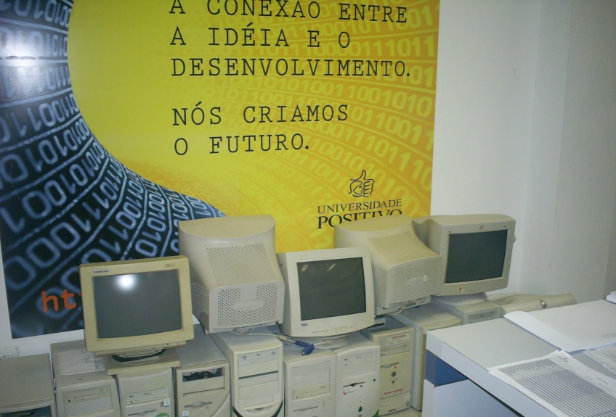
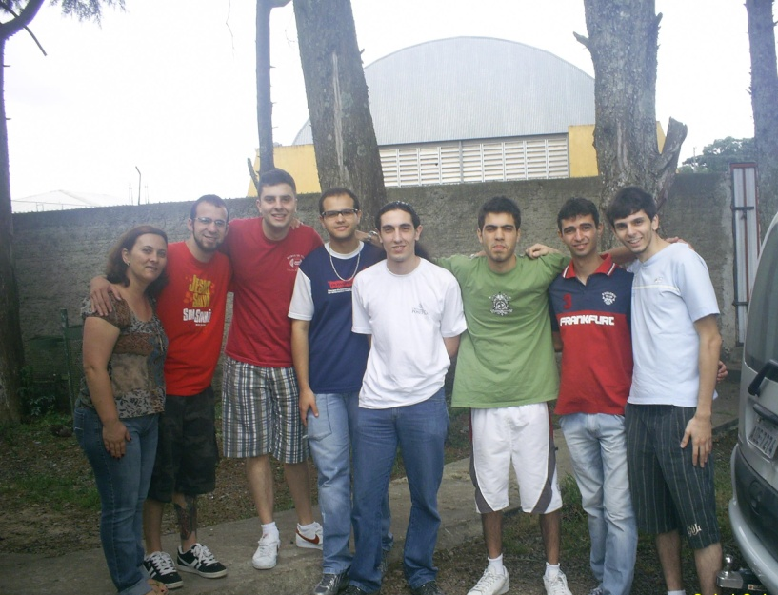
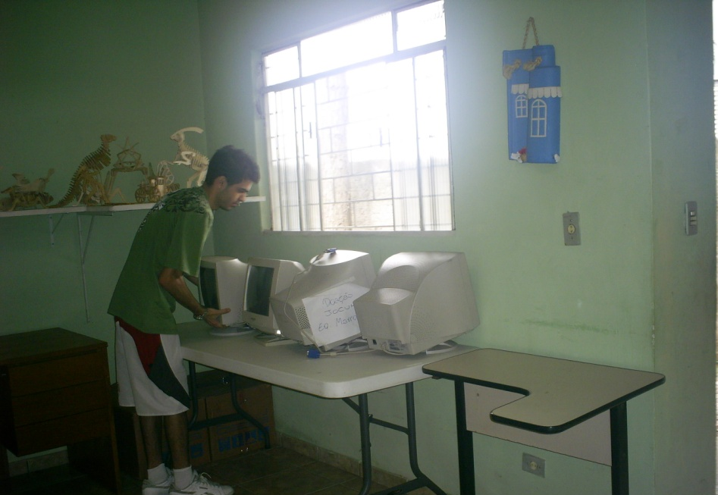
Results

Slide 7
Final Considerations
This is a pilot project that involved other disciplines, including hardware ones.
Future goal to establish an inter-courses project.
Enhance more the concern about social responsibility principles foment by Positivo University.
The enthusiasm of our classmates to be collaborating in a real way, helping other entities and people.

