Slide 1
An Attempt of Problem Based Learning by Sharing Method
Shigetoshi Ishizaki, Jun-ichi Ozaki，Shigeru Saito，
Satoru Takenawa, Takeshi Nakatsuji
Kobe City College of Technology

Slide 2
Education System in Ｊａｐａｎ
Age
27
Engineers
5
Doctoral Course
Master’s Course
The college of technology was founded as a unique type of higher level education institution in 1962.
The college of technology is called "KOSEN" in Japanese.
"KOSEN" provide junior high school graduates with a 5-years program of study (fundamental course), by which they can attain the same educational level as engineering college students.
In recent, advanced courses, which provides a 2-year program for graduates of fundamental course, were established. Graduates of advanced course receive a bachelor's degree in engineering.
26
4
25
3
24
“KOSEN”
2
23
1
22
2
Advanced
Course
4
University
21
1
3
20
5
fundamental course
2
19
4
1
18
3
3
A Senior
High School
17
2
2
16
1
1
15
3
A Junior High School
14
2
13
1
12
A Primary school

Slide 3
Kobe City College of Technology (KCCT)
Established in 1963
5 fundamental courses and 4 advanced courses
About 1,300 students are learning in KCCT now
Fundamental Course
(5-years program )
Advanced Course
(2-years program )
Mechanical Engineering (80)
- Design System Course
- System and Control Course
Mechanical System
Engineering (8)
Electrical Engineering (40)
Electrical and Electronic
Engineering(8)
Electronic Engineering (40)
Applied Chemistry (40)
Applied Chemistry(4)
Civil Engineering (40)
Civil Engineering (4)
* ( ) is student capacity.

Slide 4
Combination of PBL
Students : The third grade in Kosen
(17-18 years old)
Combination of PBL in 2008 :
The first term ・・・ Consecutive Method
Latter term ・・・ Sharing Method
Combination of PBL in 2009 :
The first term ・・・ Sharing Method
Latter term ・・・ Sharing Method

Slide 5
Consecutive Method
Plan
Do
Check
A
A
A
Drawings
Work

Slide 6
Sharing Method
Plan
Do
Check
A
B
C
Drawings
Work
Drawings

Slide 7
Consecutive Method
A
J
B
1Group 1Work
I
Plan
Do
Check
C
H
D
G
E
F

Slide 8
Sharing Method
A
J
B
I
C
Plan
↓
Do
H
D
G
E
F

Slide 9
Sharing Method
A
1Group3Works
J
B
I
Do
↓
Check
C
H
D
G
E
F

Slide 10
Consecutive Method
Weeks | Contents | Plan/Do/ Check
1 | Orientation | Plan1
2 | Discuss the work in each group | Plan2
3 | Design and drafting （1） | Plan3
4 | Design and drafting （2） | Plan4
5 | Design and drafting （3） | Plan5
6 | Design and drafting （4） | Plan6
7 | Design and drafting （5） | Plan7
8 | Submitting of drawings | Plan8
9 | Manufacture（1） | Do1
10 | Manufacture（2） | Do2
11 | Manufacture（3） | Do3
12 | Manufacture（4） | Do4
13 | Manufacture（5） | Do5
14 | Meeting to report on works | Check

Slide 11
Class scenery and works' photographs
(Consecutive Method)

Slide 12
Sharing Method
Weeks | Contents | Plan/Do/ Check
1 | Orientation | Plan1
2 | Discuss the work in each group | Plan2
3 | Design and drafting（1） | Plan3
4 | Design and drafting （2） | Plan4
5 | Design and drafting （3） | Plan5
6 | Meeting to explain on works | Plan6/Do1
7 | Submitting of drawings | Plan7/Do2
8 | Manufacture（1） | Do3
9 | Manufacture（2） | Do4
10 | Manufacture（3） | Do5
11 | Manufacture（4） | Do6/Check1
12 | Manufacture（5） | Do7/Check2
13 | Manufacture（6） | Do8/Check3
14 | Meeting to report on works | Check4

Slide 13
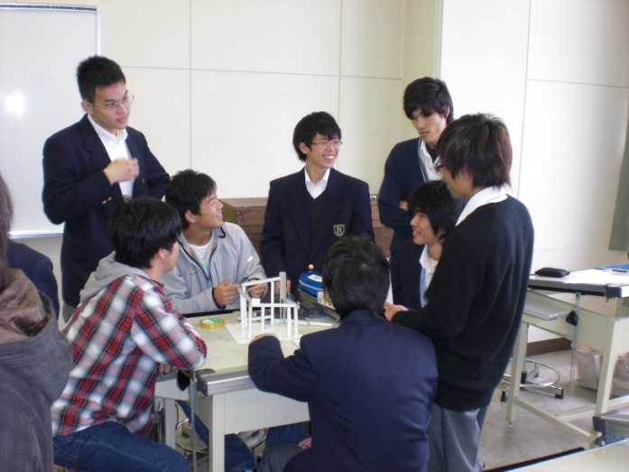
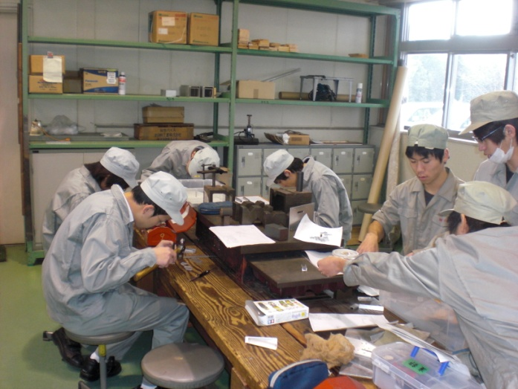
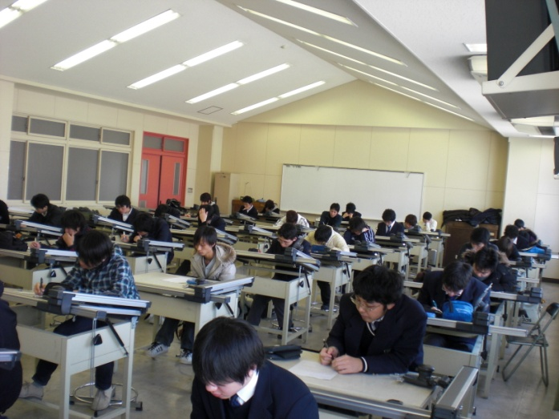
(Sharing Method)
Plan6/Do1
Do3
Check4

Slide 14
Class scenery and works' photographs
(Sharing Method)

Slide 15
Evaluation of Each Student in Consecutive Method to Seven Abilities in 2008

Slide 16
Evaluation of Each Student in Sharing Method to Seven Abilities in 2009

Slide 17
Change in Students’ Willingness in 2008

Slide 18
Change in students’ Willingness in 2009

Slide 19
Conclusions
1) We practiced two combinations of PBL by the consecutive method and the sharing method in 2008 and 2009.
2) We have investigated students' seven abilities concerning PBL of the sharing method practiced in 2008 and 2009.
3) In 2008 there was a tendency of decreasing in the abilities of students of the seventh week in the process of Plan.
4) To improve these, we had PBL by the sharing method experienced to students at the first term and latter term in 2009.
5) As a result, we succeeded in the achievement of a remarkable educational effect in students' seven abilities and willingness.

